Slide 1
Data Base
Hospital Inquiries

Slide 2
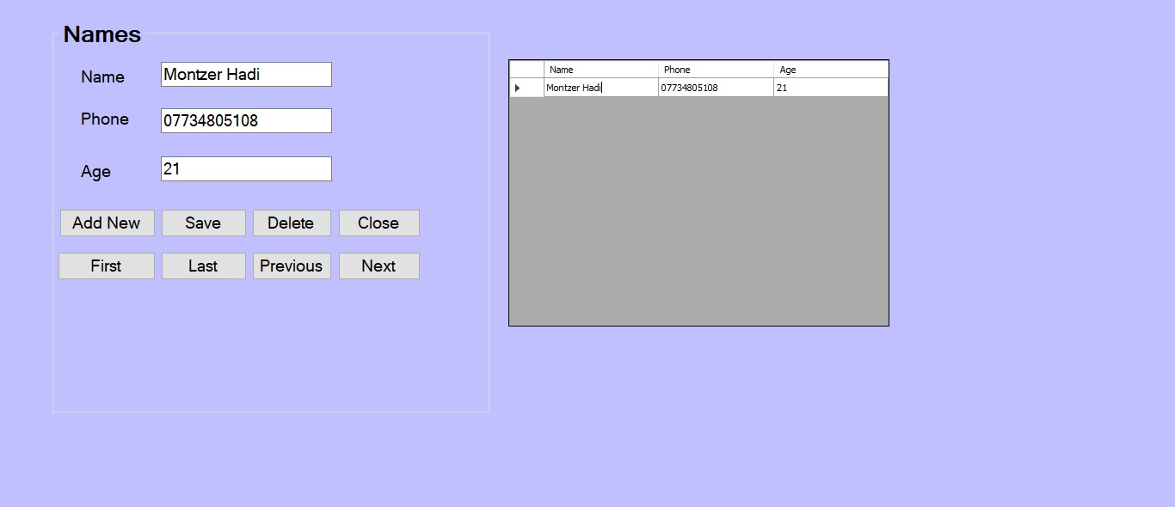
Exterior Design of The Project

Slide 3
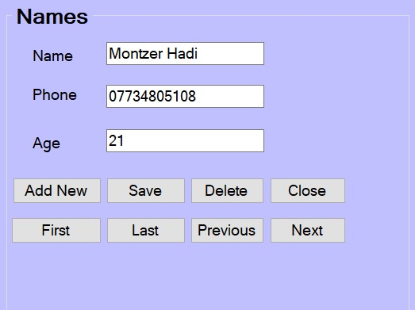
Group Box
It Contains a set of Tools, Each Tool doing a Specific Thing

Slide 4

Text box Name
The Patient’s Name is Entered from this field

Slide 5

Text box Phone
The Phone Number is Entered from this field

Slide 6

Text box Age
The Patient’s Age is Entered from this field

Slide 7


Button Add New
Through this Button, you can Add a new field

Slide 8


Button Save
Through this Button, the Information Entered Saved

Slide 9


Button Delete
Through this Button, the Information to be Deleted is deleted

Slide 10


Button Close
Through this Button, Playback is Stopped

Slide 11


Button First
Through this Button, The first field is Accessed

Slide 12


Button Last
Through this Button, The Last field is Accessed

Slide 13


Button Previous
Through this Button, you Return to the Previous field

Slide 14


Button Next
Through this Button, you Advance to the Next field

Slide 15

Preparation Team: Montzer Hadi & Taha Amin

